Slide 1
Sentinel IDS Network Intrusion Detection System

Slide 2
Project Intro
Sentinel IDS is an AI-powered network intrusion detection system that uses a stacking ensemble classifier to identify network anomalies in real-time. The system is built on the UNSW-NB15 benchmark dataset
Goal: classify network traffic as Normal or Attack
Dataset: UNSW-NB15 train and test split
System: Flask backend + React dashboard
Approach: stacked ensemble + probability calibration
Output: prediction, attack probability, threat level

Slide 3
Key Parameters The Model Checks
Traffic and Packet Behavior
dur: connection duration
spkts, dpkts: packet counts
sbytes, dbytes: byte counts
rate: traffic rate
sinpkt, dinpkt: packet timing
sjit, djit: jitter
sttl, dttl: TTL values
sload, dload: traffic load
Protocol and Pattern Indicators
proto, service, state: protocol/service/state
tcprtt, synack, ackdat: TCP timing
ct_srv_src: repeated service from source
ct_dst_ltm: repeated destination access
ct_src_dport_ltm: repeated dst port from source
ct_flw_http_mthd: HTTP method count
is_ftp_login: FTP login indicator
is_sm_ips_ports: src/dst same IP-port pattern

Slide 4
Models and Ensemble
Level-0 Input
42 UNSW-NB15 features as raw inputs.
Level-1 Base Models
RF, XGBoost, LightGBM, Extra Trees, MLP produce OOF preds.
Each base model outputs attack probability
Level-2 Meta-Learner
Logistic Regression trained on OOF features
Calibrated Output
Final calibrated threat probability score.

Slide 5
Test Metrics (Individual + Ensemble)
Model | Accuracy | Precision | Recall | F1 | ROC-AUC
Random Forest | 0.8983 | 0.9905 | 0.8588 | 0.9200 | 0.9864
XGBoost | 0.8991 | 0.9889 | 0.8614 | 0.9208 | 0.9864
LightGBM | 0.8996 | 0.9888 | 0.8622 | 0.9212 | 0.9861
Extra Trees | 0.8907 | 0.9774 | 0.8592 | 0.9145 | 0.9843
MLP | 0.8893 | 0.9849 | 0.8504 | 0.9127 | 0.9788
Ensemble Raw | 0.9012 | 0.9887 | 0.8647 | 0.9226 | 0.9874
Ensemble Calibrated | 0.9012 | 0.9887 | 0.8647 | 0.9226 | 0.9874

Slide 6
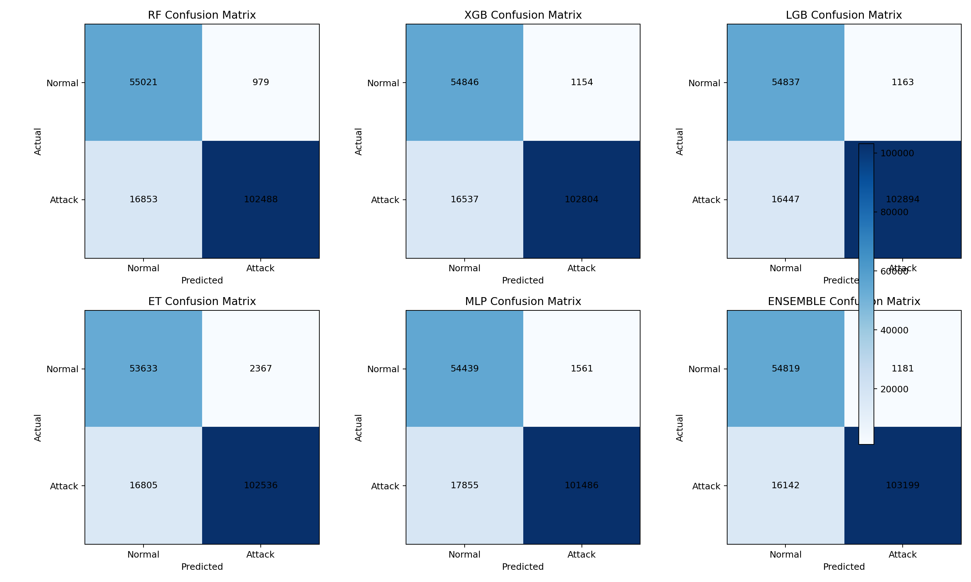
Confusion Matrix Overview
Model-wise confusion matrices on UNSW test set

Slide 7
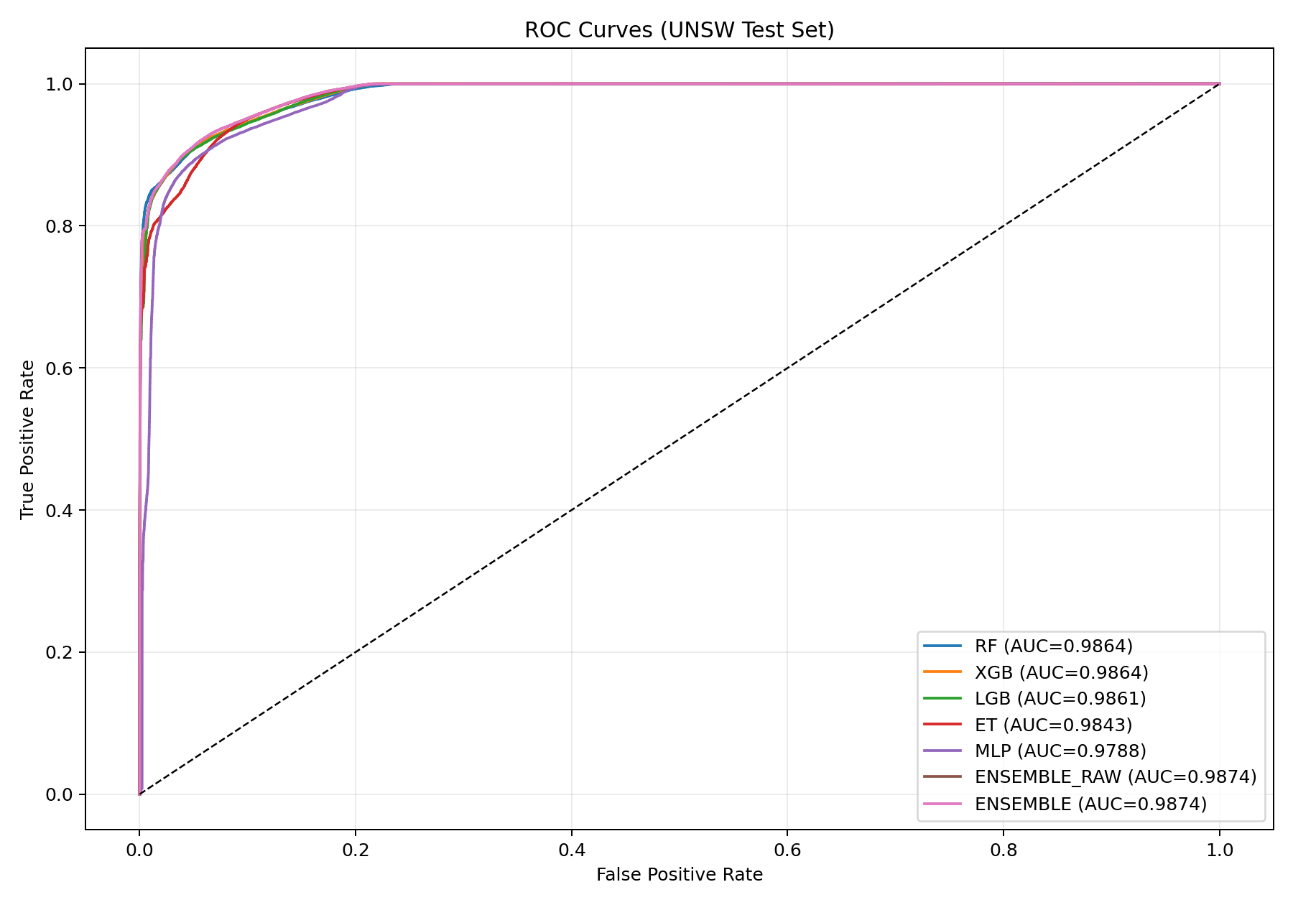
ROC Curve Comparison
AUC comparison across models

Slide 8
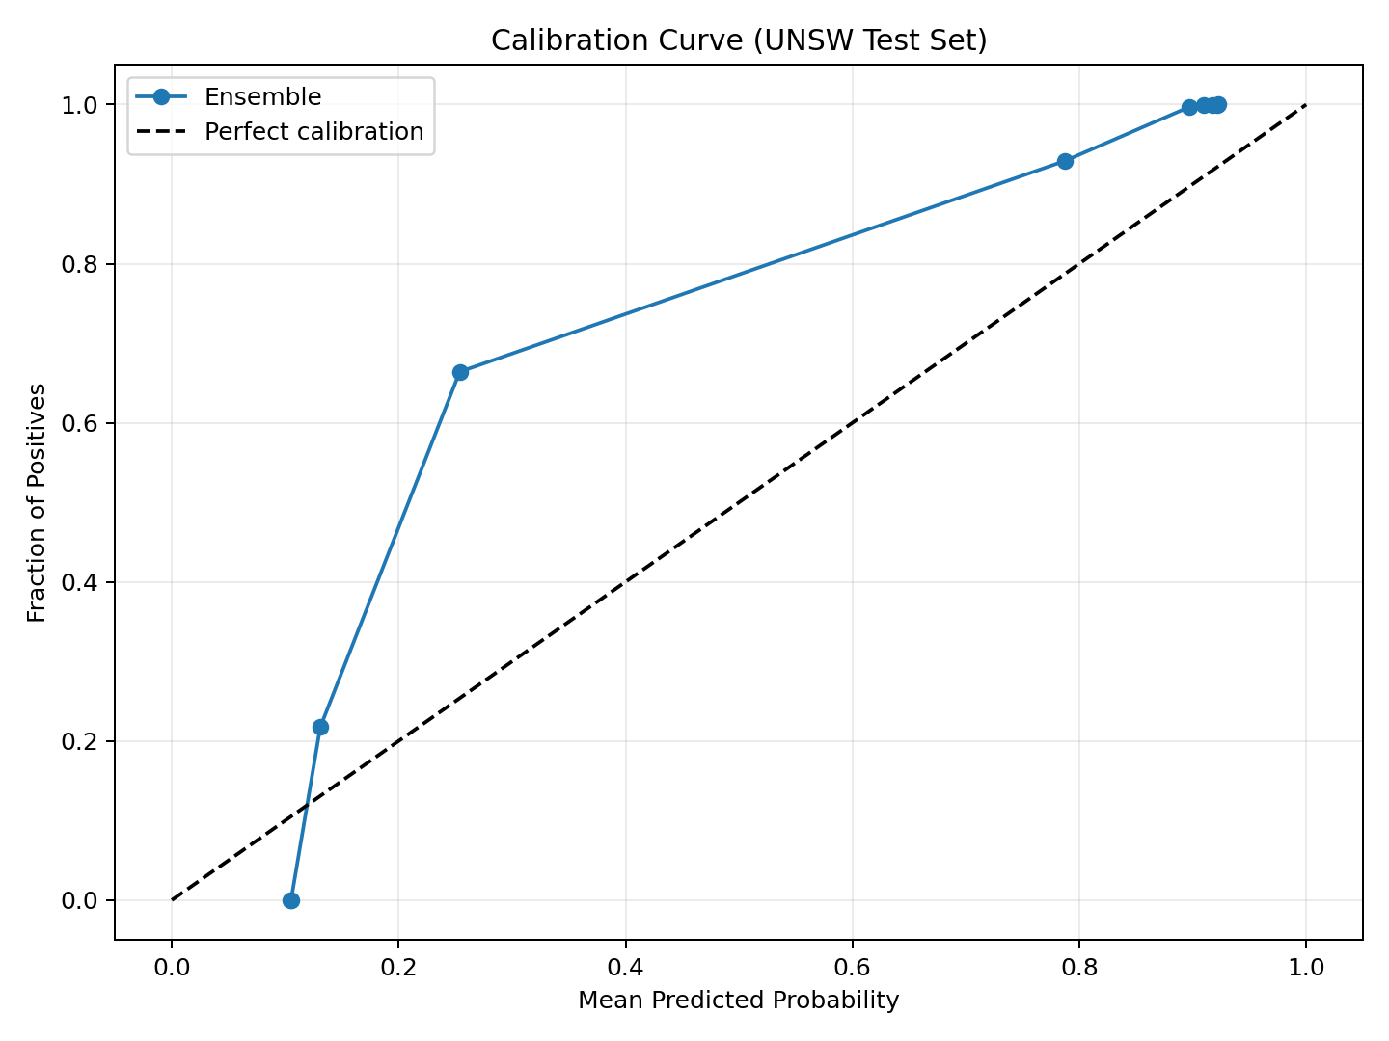
Calibration Curve
Predicted probabilities vs observed outcomes

Slide 9
Conclusion
All individual models are working and contribute to final output
Ensemble improves stability and overall performance
Ensemble test accuracy: 0.9012
Model is ready for demonstration with live dashboard

